Slide 1
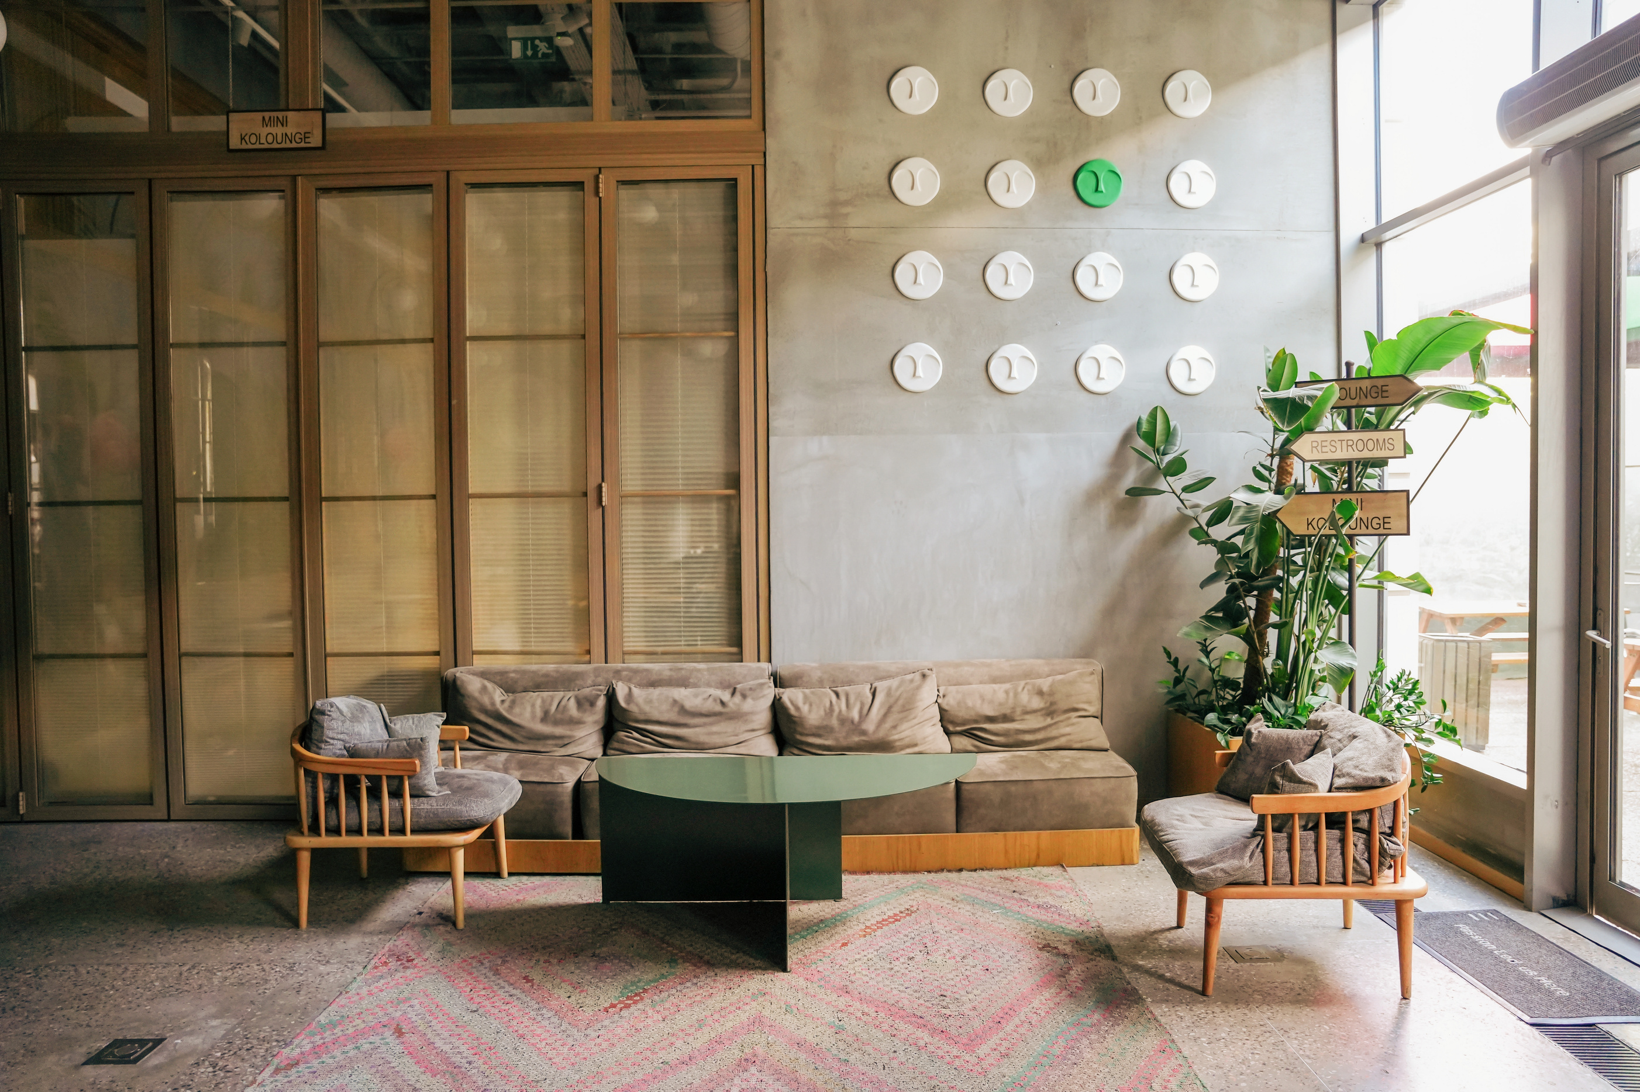

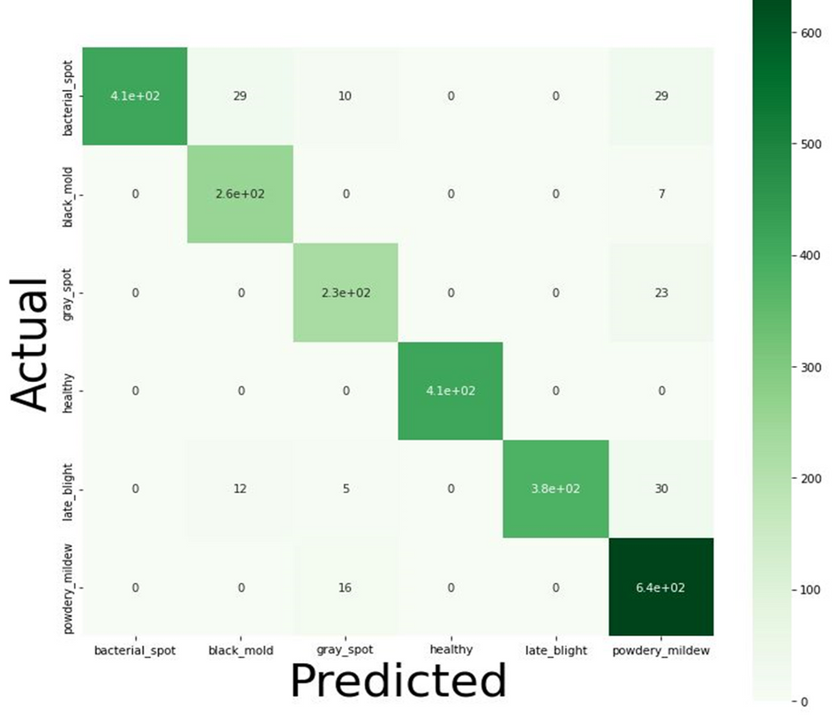
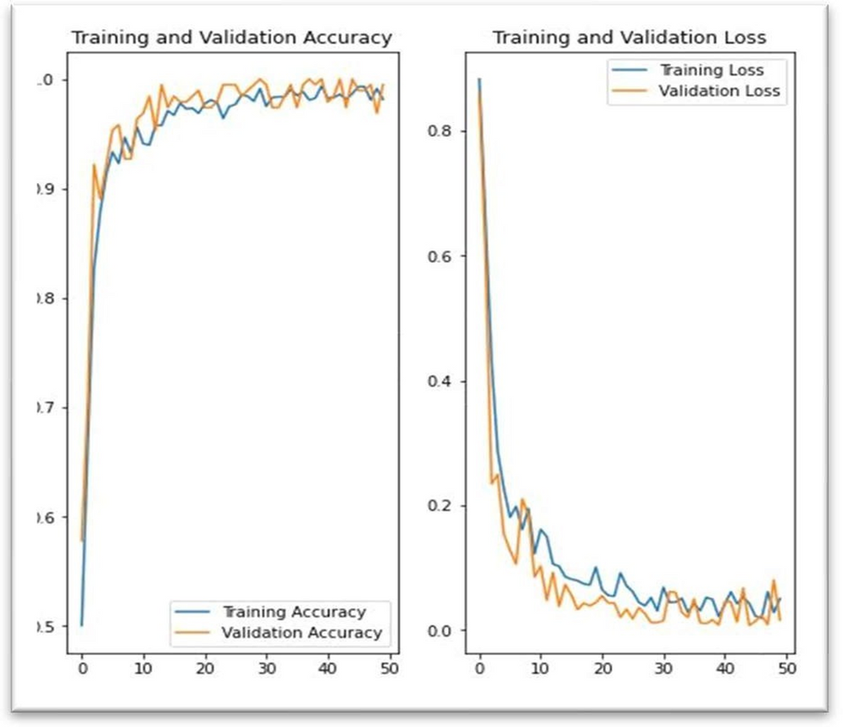
RESULT ANALYSIS

Slide 2
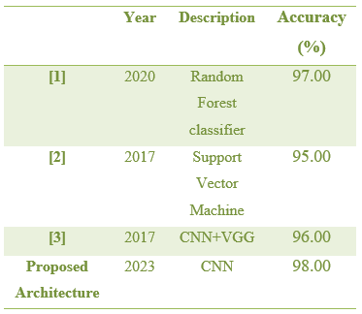
COMPARE RESULT

Slide 3
Future work (Implement in mobile)
Real-time classification
Mobile application integration
Data augmentation techniques
IoT device integration
Education and trainning

Slide 4
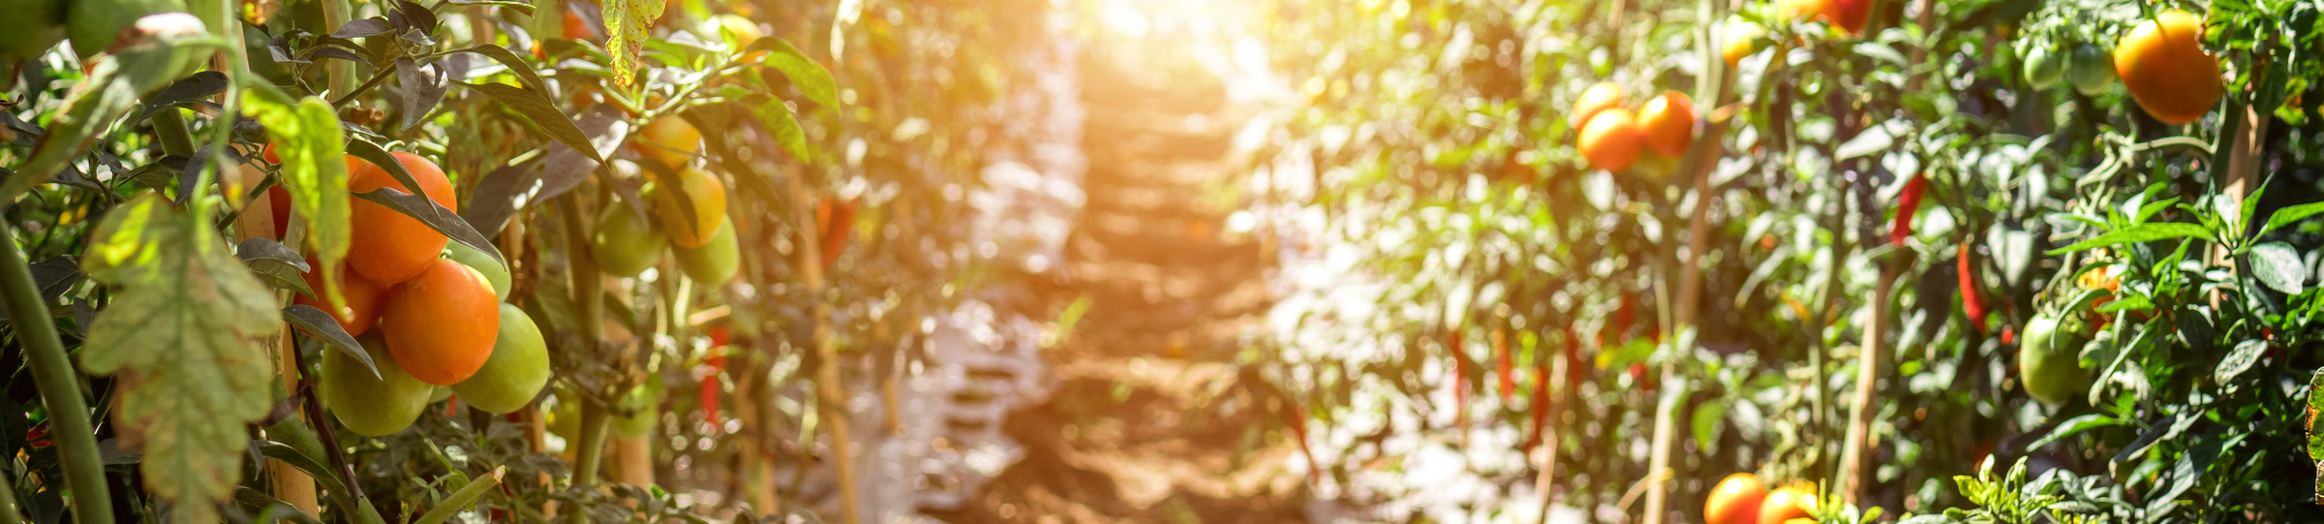
CONCLUSION
CNN for tomato diseases.
Efficient mobile design
User-centric approach
Scalability and collaboration

Slide 5


